Slide 1
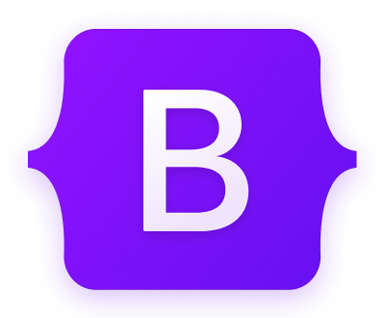
Introduction to Bootstrap
What is Bootstrap?
Bootstrap is a popular and widely-used front-end framework for building responsive and mobile-first websites and web applications. It was originally created by Twitter and is now an open-source project. The framework provides a collection of HTML, CSS, and JavaScript components and tools, making it easier for developers to design and develop modern, visually appealing, and consistent user interfaces.
Why it is used ?
Easy to use: Anybody with just basic knowledge of HTML and CSS can start using Bootstrap
Responsive features: Bootstrap's responsive CSS adjusts to phones, tablets, and desktops
Mobile-first approach: In Bootstrap 3, mobile-first styles are part of the core framework
Browser compatibility: Bootstrap is compatible with all modern browsers (Chrome, Firefox, Internet Explorer, Edge, Safari, and Opera)

Slide 2
Bootstrap Grids
•Bootstrap’s grid system allows up to 12 columns across the page.
•If you do not want to use all 12 columns individually, you can group the columns together to create wider columns:
<div class="col-md-12">Span 12 columns</div><div class="col-md-6">Span 6</div><div class="col-md-6">Span 6</div><div class="col-md-4">Span 4</div><div class="col-md-8">Span 8</div><div class="col-md-4">Span 4</div><div class="col-md-4">Span 4</div> <div class="col-md-4">Span 4</div>
•Bootstrap's grid system is responsive, and the columns will re-arrange automatically depending on the screen size.
Grid Classes
• The Bootstrap grid system has four classes:
• xs (for phones)
• sm (for tablets)
• md (for desktops)
• lg (for larger desktops)
• The classes above can be combined to create more dynamic and flexible layouts.

Slide 3
Different concepts of Bootstrap
Collapsible
A "collapsible" refers to a UI element that can be expanded or collapsed to show or hide its content. The most commonly used collapsible component in Bootstrap is the "collapse" class, which is often combined with other elements like buttons or links to create interactive collapsible sections.
Jumbotron
A "jumbotron" is a large, prominent, and flexible component used to showcase key content or messages at the top of a web page. It is a container that provides a visually appealing and attention-grabbing presentation, often used for highlighting important information or making an impactful introduction.
Pagination
The pagination component consists of a series of links or buttons that represent different pages. By clicking on these links or buttons, users can move to the next or previous page, or jump to a specific page within the paginated content. This is commonly used in scenarios where you have a long list of items, search results, or any data that needs to be split into manageable chunks.
Breadcrumb
Breadcrumb is a navigation component that provides users with a hierarchical representation of the current page's location within a website or application. It resembles a trail of links, showing the path the user has taken to reach the current page, typically organized in a horizontal layout.

